Slide 1
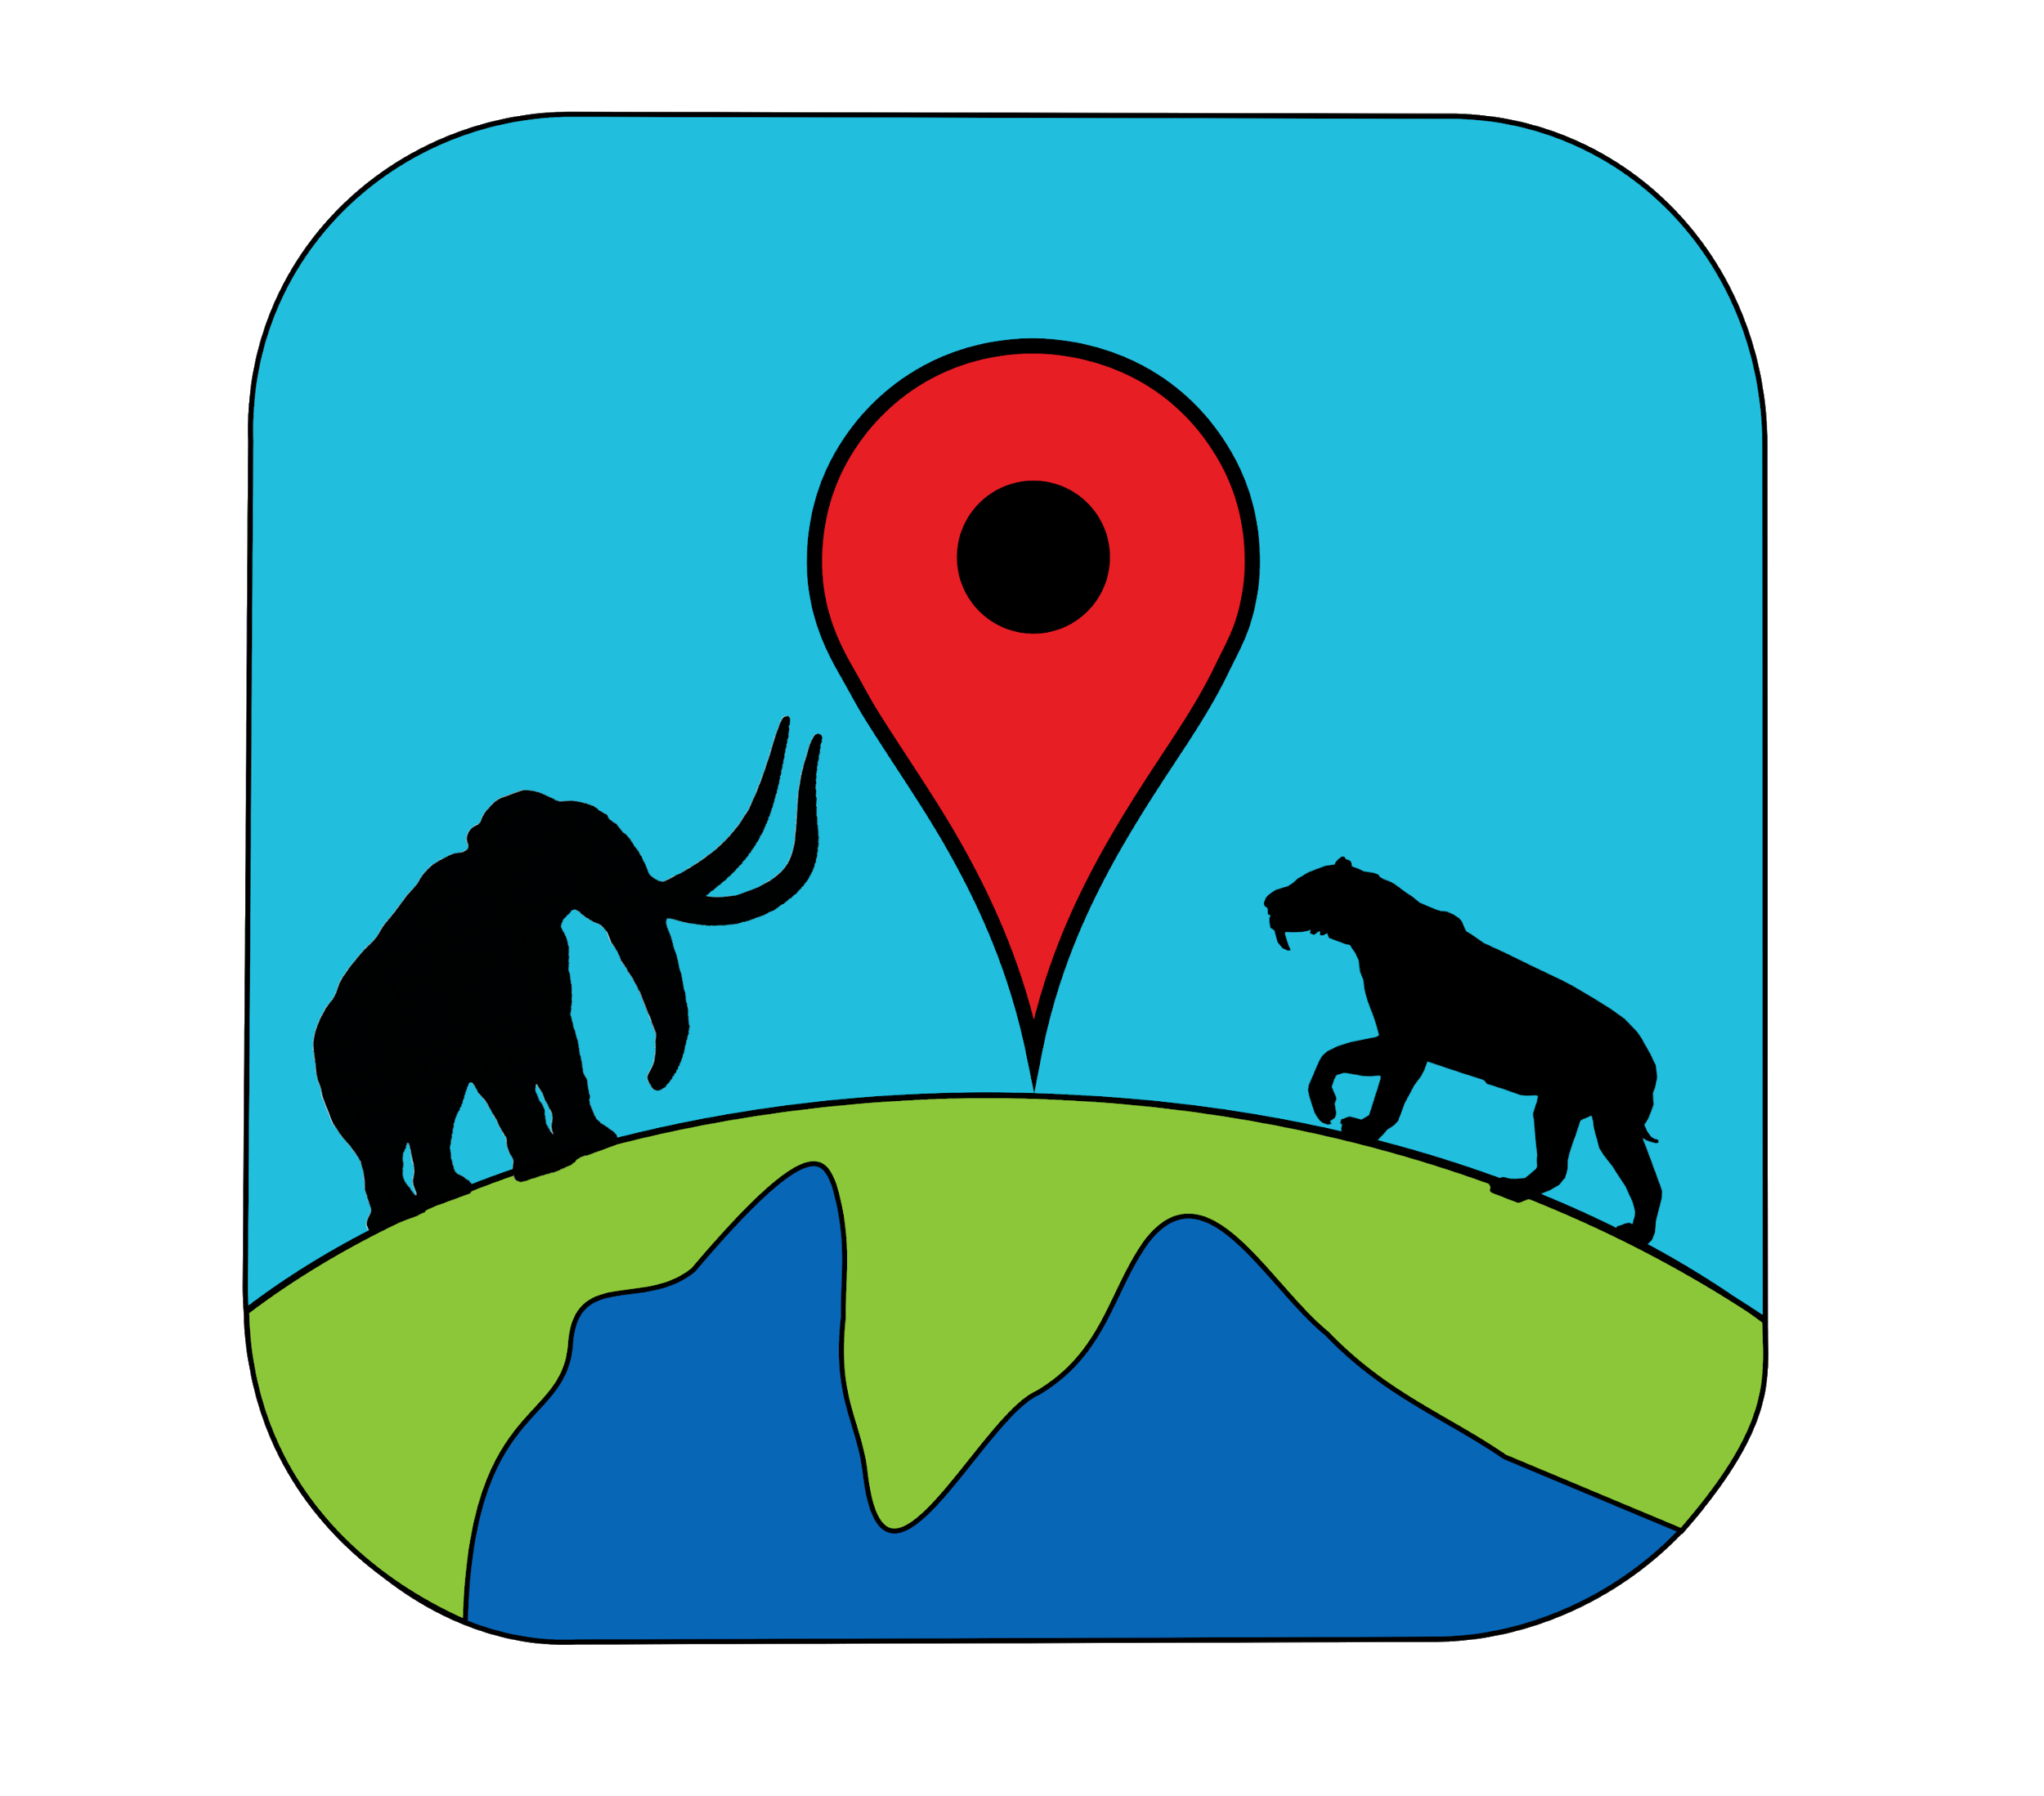
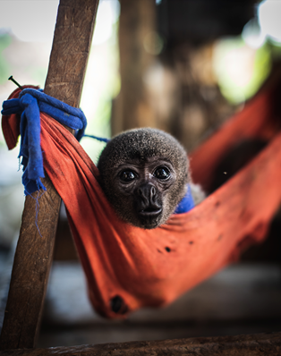
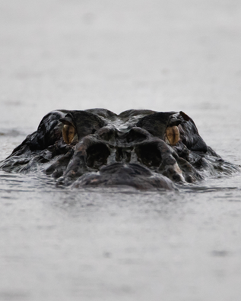
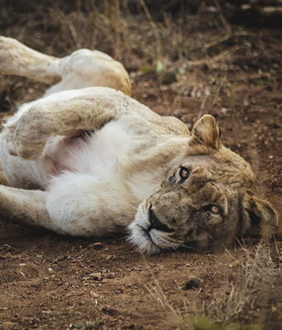
Megafauna
Produced for: [insert school name]
Date downloaded: [date downloaded]

Slide 2
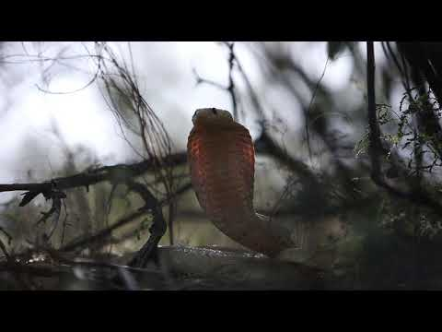

Slide 3
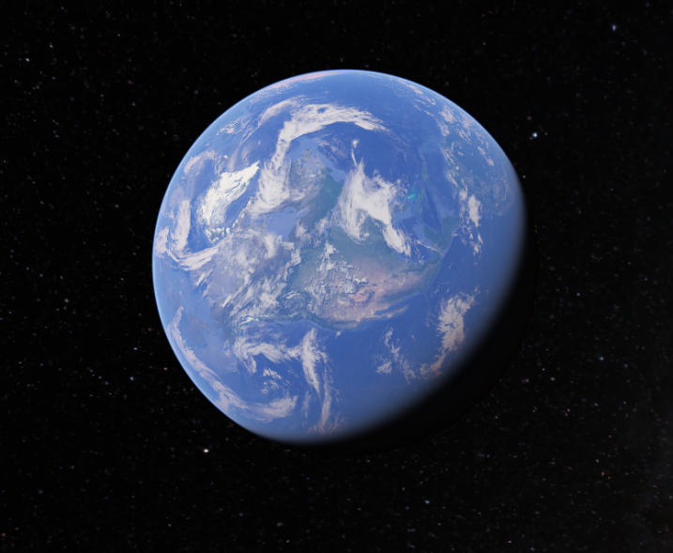
Where are you?
Click here

Slide 4
So, what are megafauna?
Megafauna is a scientific word, used to describe any animal that weighs more than 44.5 kg (or 100 lbs).
So, that means all these animals are megafauna…

Slide 5
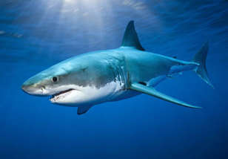
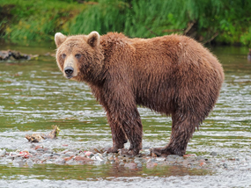
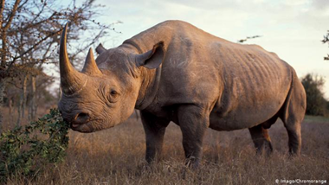
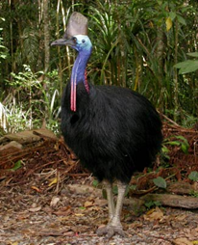
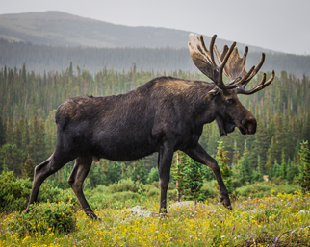
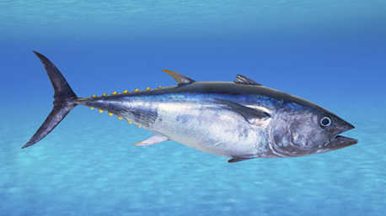
Can you name them?
Great white shark
Brown bear
Black rhino
Cassowary
Moose
Blue-fin tuna

Slide 6
Most megafauna are mammals
Mammals are warm-blooded animals in the animal class of Mammalia.
Since the extinction of dinosaurs 65 million years ago, mammals have risen to dominance across Planet Earth.
They live in both the ocean and on land.
At 130,000kg the blue whale (a mammal) is the largest animal to have ever lived on Planet Earth. Bigger than any of the dinosaurs even!

Slide 7
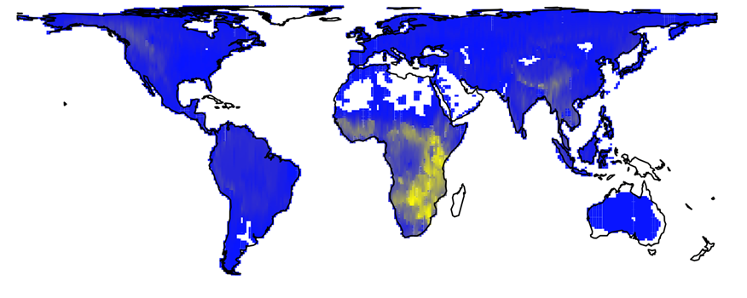
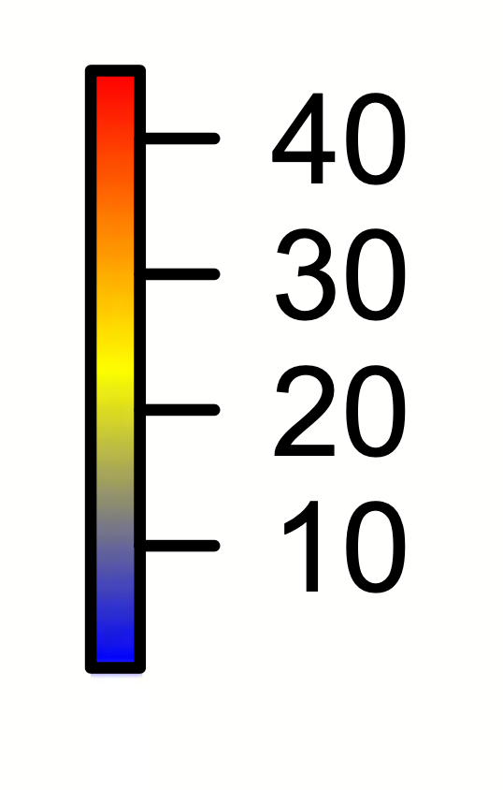
Where do mammal megafauna live today?
The number of mammal megafauna (>44.5kg or 100lbs) living on land today

Slide 8
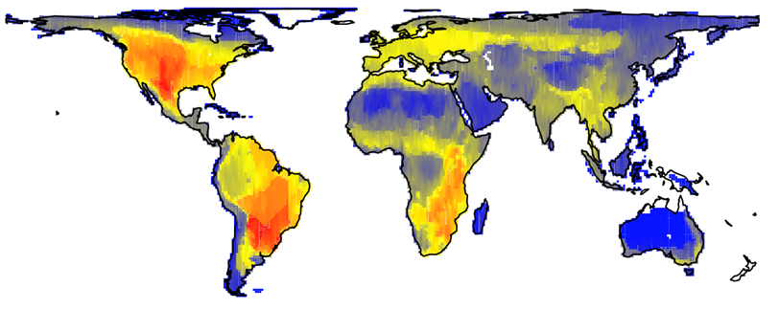
But, across the world there were many more mammal megafauna in the past
The number of mammal megafauna (>44.5kg or 100lbs) living on land in the past

Slide 9
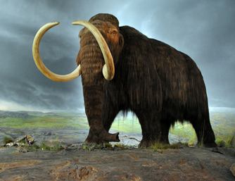
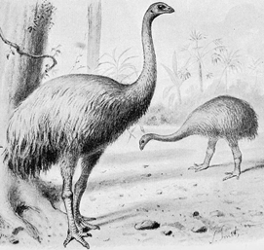
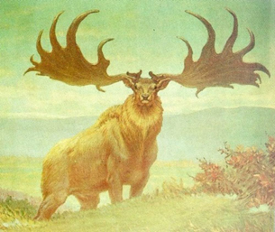
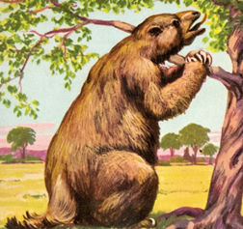
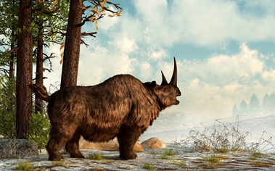
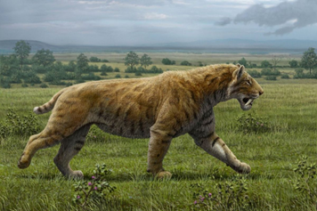
Some recently extinct megafauna
Wooly mammoth
Moa
Irish elk
Ground sloth
Wooly rhino
Saber-toothed cat

Slide 10
There are 5 ways megafauna are important for a healthy planet
Vegetation structure
Food webs
Plant composition
Soil fertility
Global climate

Slide 11
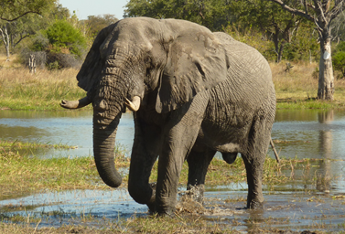
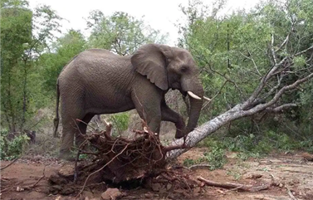
1. Vegetation structure
Big animals are powerful.
For example, an elephant’s trunk has over 100,000 muscles. This helps it rip trees straight from the ground.
All those broken trees provide opportunities for other animals and plants to thrive.

Slide 12

So, what is the largest herbivore that lives near [insert school name]
Note: A herbivore is an animal that eats only plants
[insert name largest herbivore]
Weighing in at [insert body mass from csv 1] kg

Slide 13
How about the second largest herbivore near [insert school name]?
[insert name second largest herbivore]
Weighing in at [insert body mass from csv 2] kg

Slide 14
But in the past, these large herbivores also used to live near [insert school name]
[insert name herbivore 1]
[insert name herbivore 2]
[insert name herbivore 3]
[insert name herbivore 4]
[insert name herbivore 5]
[insert name herbivore 6]

Slide 15
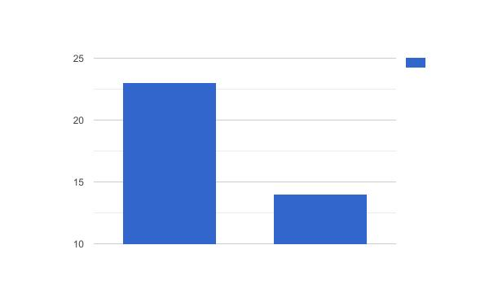
In total, [herbExt]% of herbivores >1kg have gone extinct near [insert school name].
Number of Herbivores
Non-extinct Extinct
Notes:
Label y axis = “No. of herbivores”
Label x-axis = left bar is ”Historic”, right bar is “Current”

Slide 16
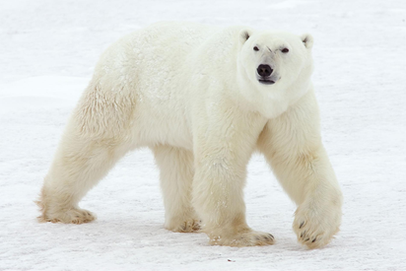
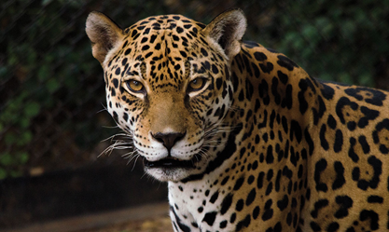
2. The food web
Big predators eat a lot of other animals.
For example, a single polar bear can eat over 50 seals each year. Their stomachs are large enough to hold 80 kg of food in one go. That’s 40x more than the average adult human can!
All that eating controls prey numbers, the effects of which trickle through the entire food web.

Slide 17
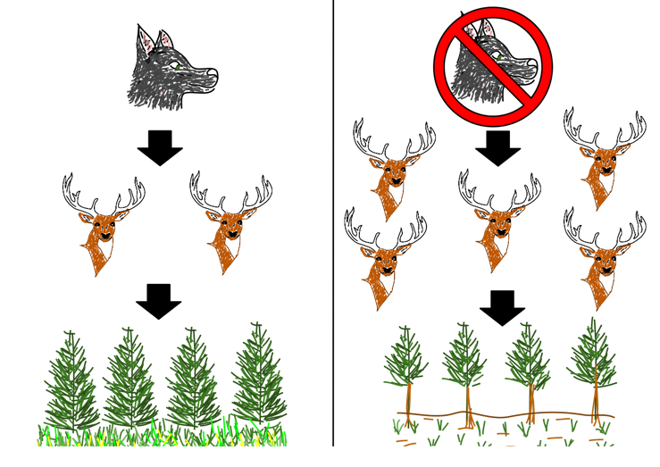
In this way, wolves help the trees grow…

Slide 18
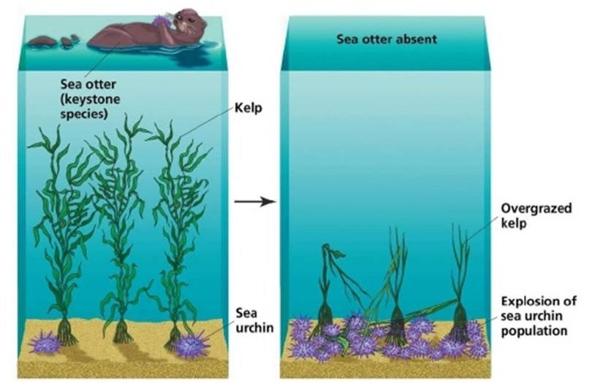
… and otters help the sea kelp!

Slide 19
So, what is the largest predator that lives near [insert school name]
Note: A predator is an animal that eats other animals
[insert name largest predator]
Weighing in at [insert body mass from csv 3] kg

Slide 20
How about the second largest predator near [insert school name]?
[insert name second largest predator]
Weighing in at [insert body mass from csv 4] kg

Slide 21
But in the past, these predators also used to live near [insert school name]
[insert name predator 1]
[insert name predator 2]
[insert name predator 3]
[insert name predator 4]
[insert name predator 5]
[insert name predator 6]

Slide 22
In total, [predExt]% of predators >1kg have gone extinct near [insert school name].
Number of Predators
Non-extinct Extinct
Notes:
Label y axis = “No. of predators”
Label x-axis = left bar is ”Historic”, right bar is “Current”

Slide 23
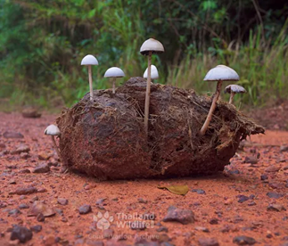
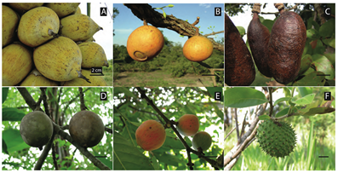
3. Vegetation composition
Animals are important for transporting seeds across the landscape.
Megafauna often travel large distances between eating a seed in one place and dropping it off somewhere else.
Megafauna are also the only animals capable of eating large seeds. Imagine trying to swallow an entire avocado seed!
Some megafauna fruits

Slide 24
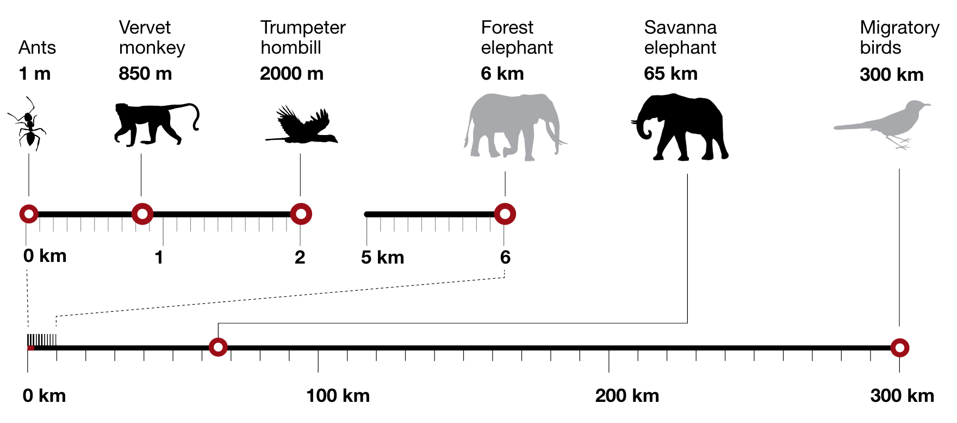
Recent scientific studies show that large animals and those that can fly tend to carry seeds further. This helps plants colonise new places and respond to changing environments.

Slide 25

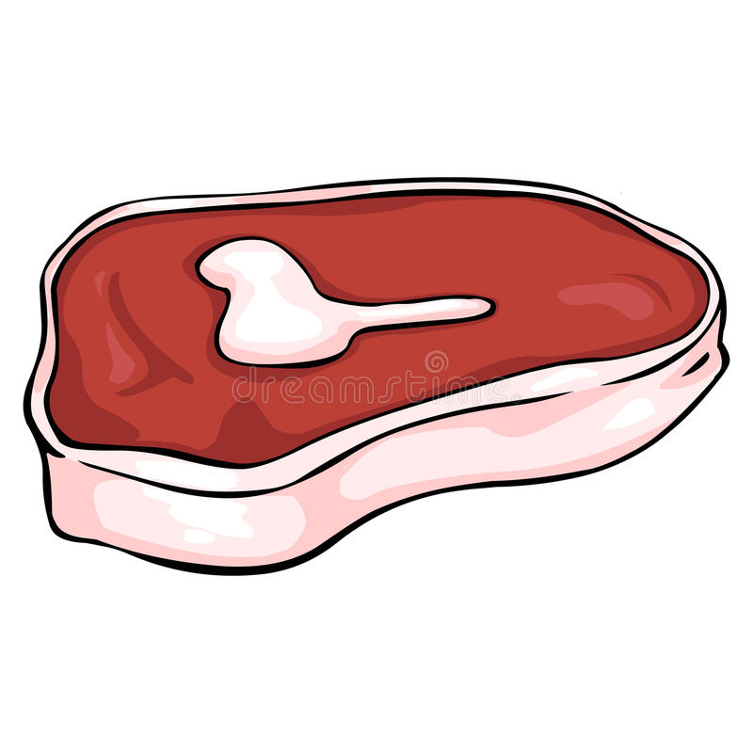
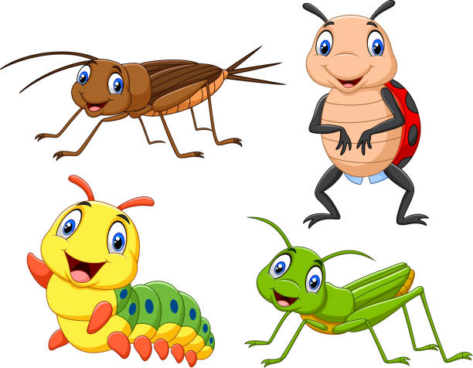
So, what’s in the diet of megafauna living near [insert school name]?
Eats [X1] % of plant, [Y1]% of meat and [Z1]% of insects in its diet…
[insert name animal 1]
Eats [X2] % of plant, [Y2]% of meat and [Z2]% of insects in its diet…
[insert name animal 2]

Slide 26
Eats [X3] % of plant, [Y3]% of meat and [Z3]% of insects in its diet…
[insert name animal 3]
Eats [X4] % of plant, [Y4]% of meat and [Z4]% of insects in its diet…
[insert name animal 4]
Eats [X5] % of plant, [Y5]% of meat and [Z5]% of insects in its diet…
[insert name animal 5]

Slide 27
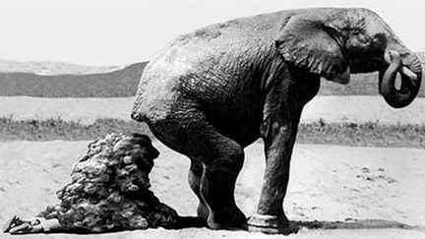
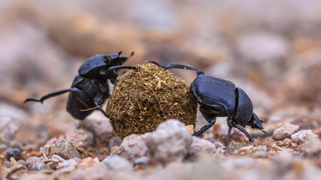
4. Ecosystem fertility
Megafauna poo, a lot!
For example, an elephant can eat up to 300kg of vegetation per day. That results in up to 100kg of dung.
Note: This is a cartoon!
Some animals, such as dung beetles need this poo to survive.
Dung is also rich in important nutrients, which helps fertilise the soil.

Slide 28
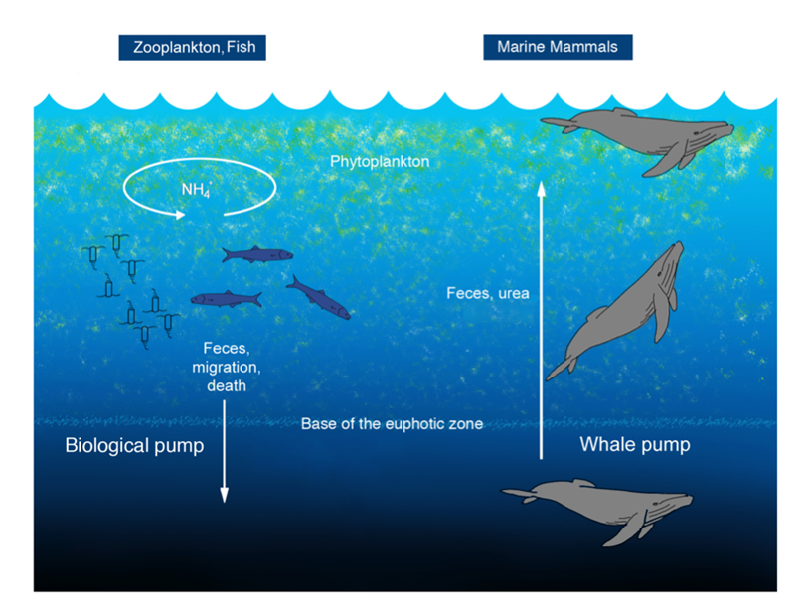
For example, whales are an important component of a healthy ocean.
They bring nutrients from the deep ocean to the sunlight. This helps plankton to grow and feed animals that live in the ocean.

Slide 29
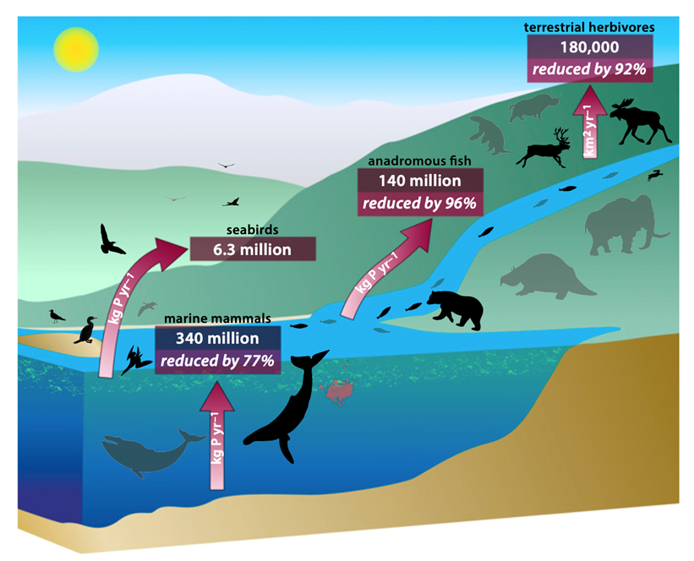
But the loss of large animals has drastically reduced the transport of important nutrients around the world.

Slide 30
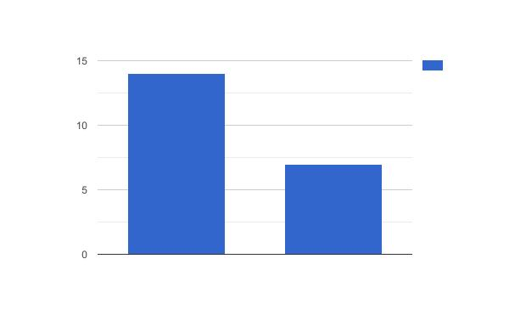
How has animal fertilisation changed near [insert school name]?
Nutrient Diffusion
Non-extinct Extinct
Notes:
Graph of past and present nutrient diffusivity based on animals present.
For each species nutrient diffusion is estimated by 0.05*BM^1.17, where BM is the body mass of the animal in kg.
Then add up total nutrient diffusion for all species present in historic and current.
Label the y-axis “Nutrient Diffusion” we’ll do away with units as they are confusing.
Email me if you need help clarifying.

Slide 31
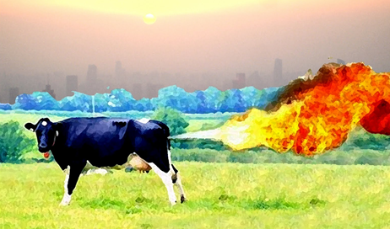
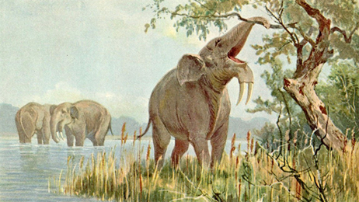
5. Global climate
The combined effects of megafauna can impact global climate.
This can be directly. For example, cows are known to produce a lot of methane, which warms the planet.
And indirectly, through their impacts on plants and soil fertility.

Slide 32
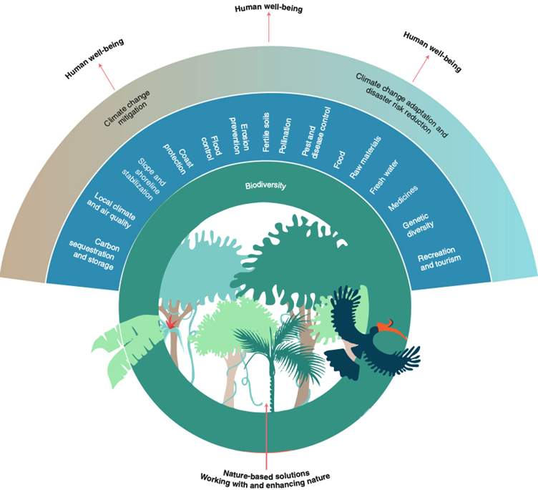
In this way, conservation efforts that promote the protection of megafauna can help regulate climate change…
..as well as many other benefits

Slide 33
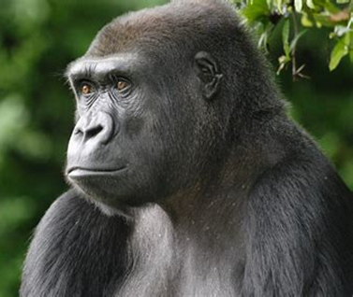
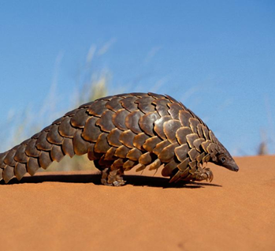
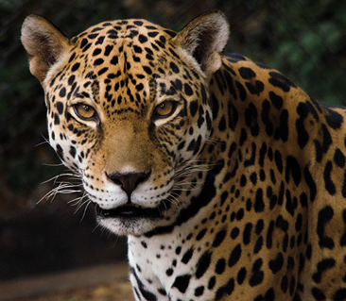
But, today, large mammal populations are declining.
You can visit the WWF website here to look through a list of all large animals that are endangered

Slide 34
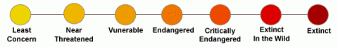
How are megafauna doing near to [insert school name]?
[insert name threated 1]
Threat Level: [threat level 1]
[insert name threated 2]
Threat Level: [threat level 2]
[insert name threated 3]
Threat Level: [threat level 3]

Slide 35
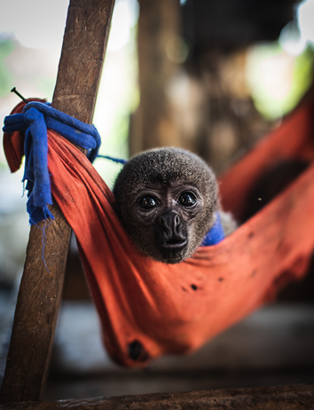
What things can do to help?

Slide 36
Key learnings
Megafauna are important for a healthy planet:
Vegetation destruction
Food webs
Plant composition
Soil fertility
Global climate
Megafauna species need greater protection across the world

Slide 37
